Slide 1
Import Export Analysis
Group Member:
Vipul Sharma
Dhruva Sharma
Nitish Sharma
JS.Radhe Shyam
Nitin Jain

Slide 2
Contents
Introduction
Technology Used
What is Big Data
Map Reduce Concept
Our Analysis
ScreenShots
Key Results

Slide 3

Introduction
Idea
To analyse the Export data set of India Of the Year 2011-12 and 2012-13 and Compare them.
Source Of Data Set
We gathered data from different sites to generate the Data Set so that we can analyse.

Slide 4
Technology Used
Linux
We used this platform because of its highly customisability.
Hadoop
Platform for handling Big Data by using clustering.
Hive
For Analysis over found semi-structured Data set .
Other Tools
Sqoop (for connecting mysql and hive), MySql, putty, winscp

Slide 5
What is Big Data
Big Data is a collection of large dataset that can not be processed using traditional computing techniques.
Eg : The volume of Data Facebook or Youtube need require it to collect and manage on a daily basis under the category of Big Data.

Slide 6
Map Reduce
MapReduce is a programming model for writing application that can process Big Data in parallel on multiple nodes.
MapReduce algorithm contain 2 important tasks, namely Map and Reduce.
The Map task and taskes a set of data and converts it into another set of data, where individual elements are broken into tuples(Key-Value pairs).
The reduce task takes the output from the map as an input and combines those data tuples(key-values pairs) into a smaller set of tuples

Slide 7
Our Analysis
Dhruva Analysis

Slide 8
Nitish Sharma Analysis

Slide 9
Vipul Sharma Analysis

Slide 10
Radhe Analysis

Slide 11
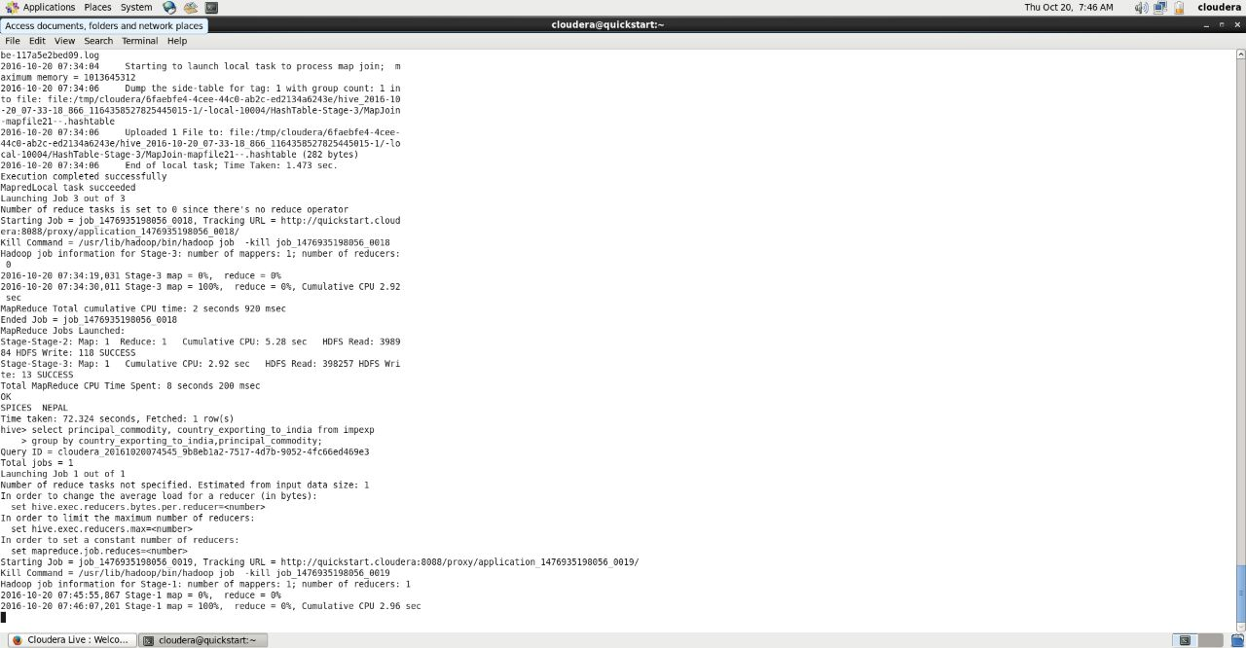
Screen Shots

Slide 12
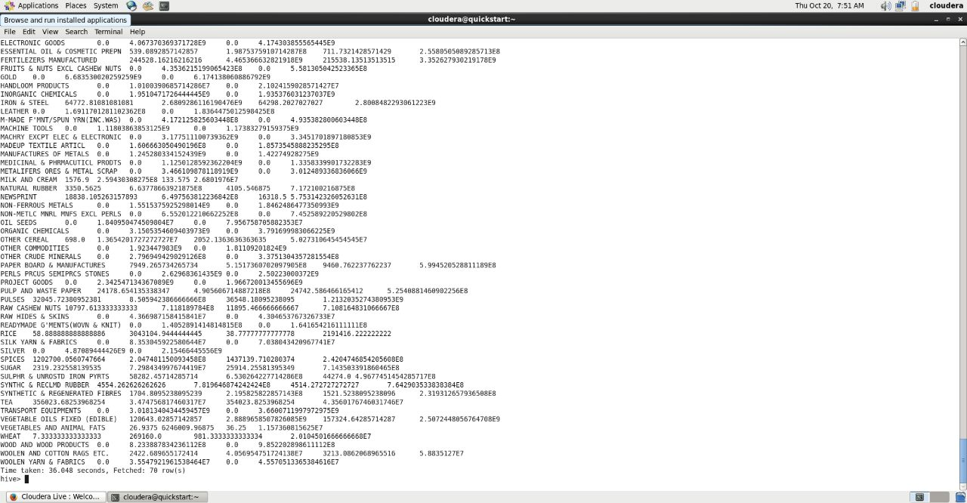
Contd..

Slide 13
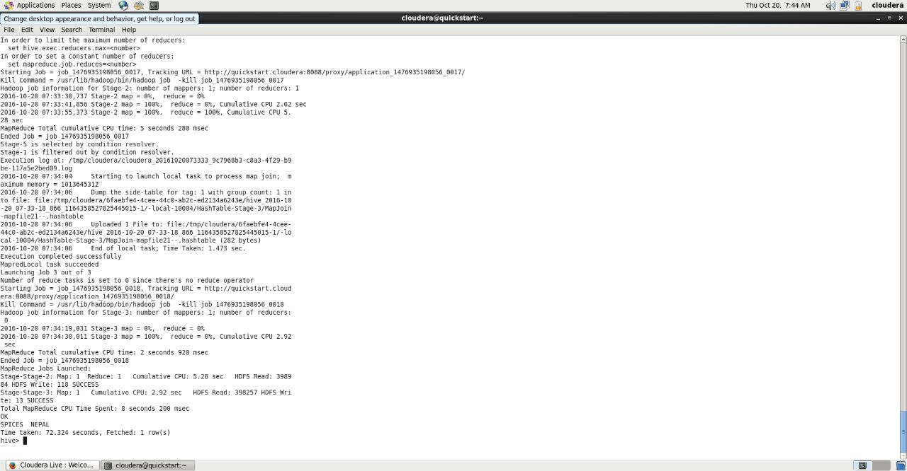
Contd..

Slide 14
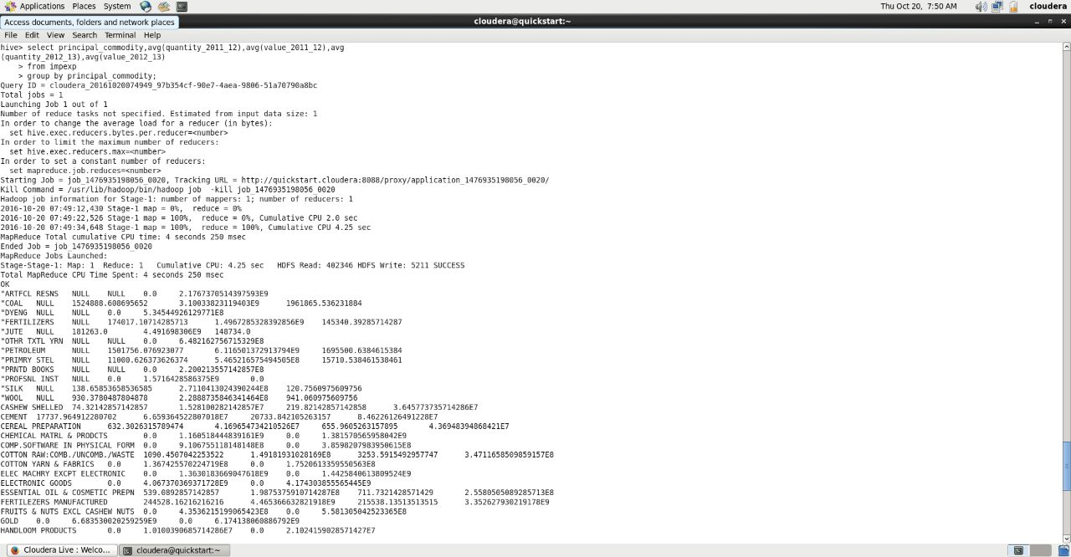
Contd..

Slide 15
Key Result
Top ten petroleum and crude oil exporter.
Unspecified country Exporting to India.
Maximum commodity exported by which country.
Increase and Decrease In commodity exported and imported by India.
Relationship With other countries In trading

